Slide 1
This resource sponsored by Clarity Innovations
Personalized Learning
A Guide for Engaging Students with Technology

Slide 2
What IS Personalized Learning?
A variety of instructional approaches and academic-support strategies to address the distinct learning needs, interests, aspirations, or cultural backgrounds of individual students.

Slide 3
Characteristics of Personalized Learning Environments
Student-centered instruction
Engagement in real-world activities that promote content learning
Student choice and control
Formative assessment throughout the learning cycle
Seamless integration of technology into learning experiences

Slide 4
Why Implement Personalized Learning?
To improve student achievement
To help students meet academic standards
To address the needs of all students
To engage students by connecting their out-of-school and in-school lives

Slide 5
Keys to Effective Implementation
of Personalized Learning
•Leadership
•Technology policy
• Collaborative planning
• Professional development

Slide 6
Research conducted by Project RED (2010) found that educational technology has the most impact when it is fully integrated into every aspect of the learning experience. When students have one-to-one computers available and numerous opportunities to creatively demonstrate their learning and stretch their minds, they achieve far beyond the achievement levels attained when they all follow the same path at the same rate.
Percentage of respondents reporting improvement GREAVES, ET AL., 2010, PROJECT RED. Reprinted courtesy of the publisher.

Slide 7
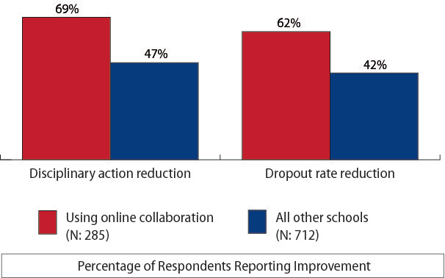
Personalized Learning
Percentage of respondents reporting improvement GREAVES, ET AL., 2010, PROJECT RED. Reprinted courtesy of the publisher.

Slide 8
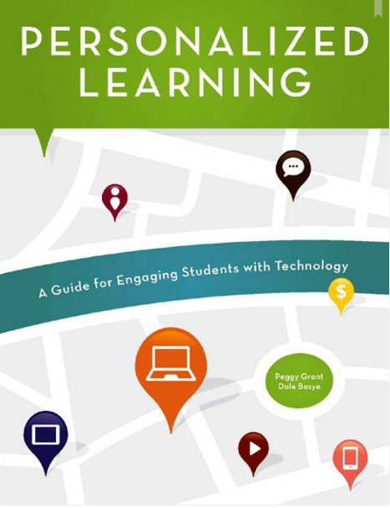
Mobile

Slide 9
Written for principals and their professional learning networks, but also relevant to educators, Personalized Learning: A Guide for Engaging Students with Technology has useful information along with activities to help you think about the concepts in the book and how to put them into practice. Facilitator guides to accompany the book are also available to further the professional development of today’s teachers and principals.

Slide 10
“Personalized learning is an invitation for educators to create opportunities for learning that takes advantage of the digital skills most students already possess.”
Introduction to Personalized Learning
—Paige Johnson, Education Strategist, Intel Corporation; ISTE Board of Directors

Slide 11
The Authors
Peggy Grant, a classroom teacher for over twenty years and teacher educator is a senior content developer at Clarity Innovations. She creates online and face-to-face courses and other resources to facilitate the transformation of classrooms into places where students are actively learning with technology. Peggy’s goal is to provide educators with the tools they need to make every classroom a place where students are engaged in learning.
Dale Basye, an award winning author and creative director, is a content developer at Clarity Innovations where he works directly with teachers and schools on technology integration. He is also the author of The Circles of Heck, a book series for young adults. Dale’s diverse skills and his experiences with children give him a unique perspective on educational practices that engage and inspire students in the 21st century.

Slide 12
Personalized Learning Chapters
Why Consider Personalized Learning
A Vision of Online and In-Person Learning to Meet Student Needs
How Can One-to-One Personalized Learning Transform Teaching?
One-to-One Computing and Personalized Learning

Slide 13
Personalized Learning Chapters
Making Personalized Learning Work for You
Devices and Services
One-to-One Program Formats
Funding
9. A Planning Process for a One-to-One
Personalized Learning

Slide 14
Personalized Learning
Features
Classroom scenarios of personalized learning with technology
Tips
Forms, surveys, and checklists to help educators plan and implement personalized learning initiatives

Slide 15
Personalized Learning
Features
Recommended resources
Exercises throughout for reflection, discussion, and planning
Additional facilitation guides to accompany the book available for professional development for principals and teachers

Slide 16
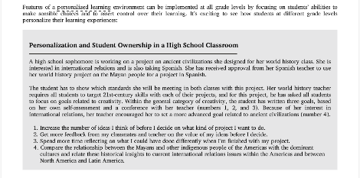
Personalized Learning Features
Classroom Examples

Slide 17
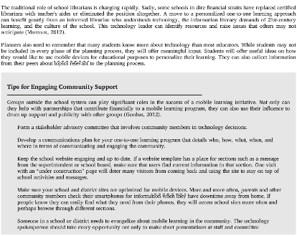
Personalized Learning Features
Tips

Slide 18
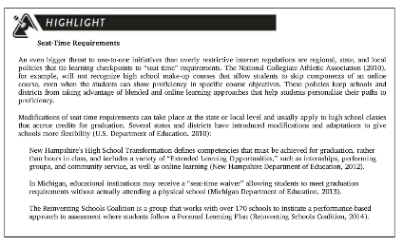
Personalized Learning Features
Highlights

Slide 19
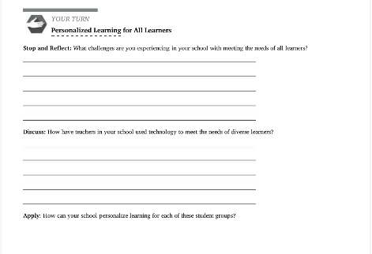
Personalized Learning Features
Your Turn: Reflection, Discussion, and Application

Slide 20
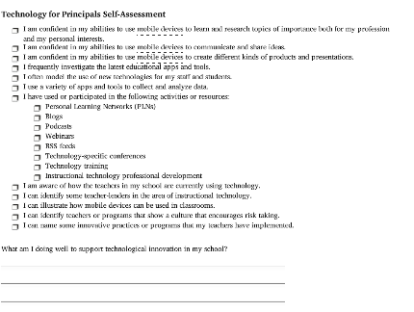
Personalized Learning Features
Forms, Surveys, and Checklists

Slide 21
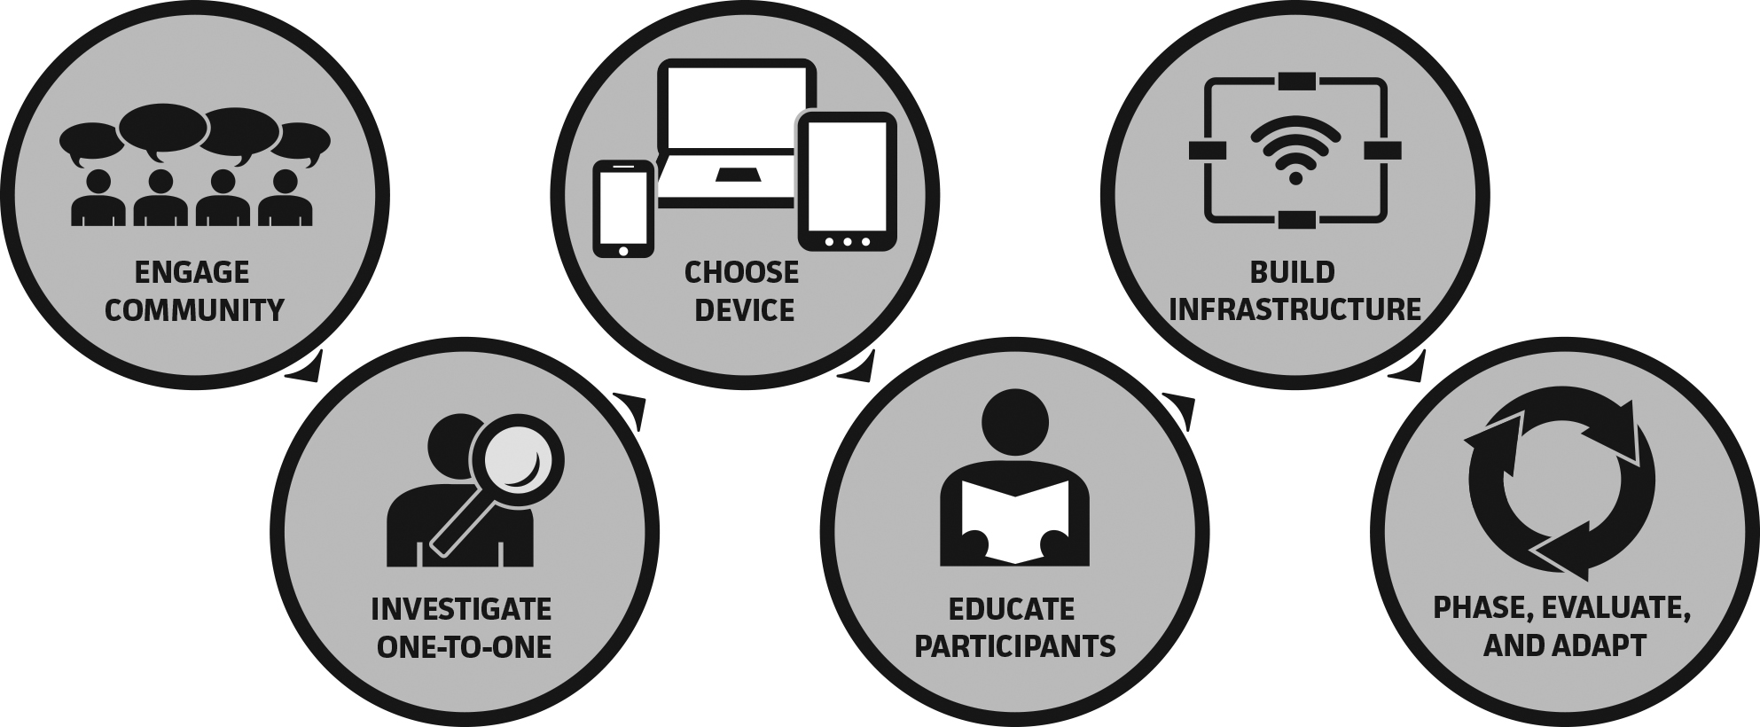
Personalized Learning
A Planning Process for a One-to-One, Personalized Learning Program

Slide 22
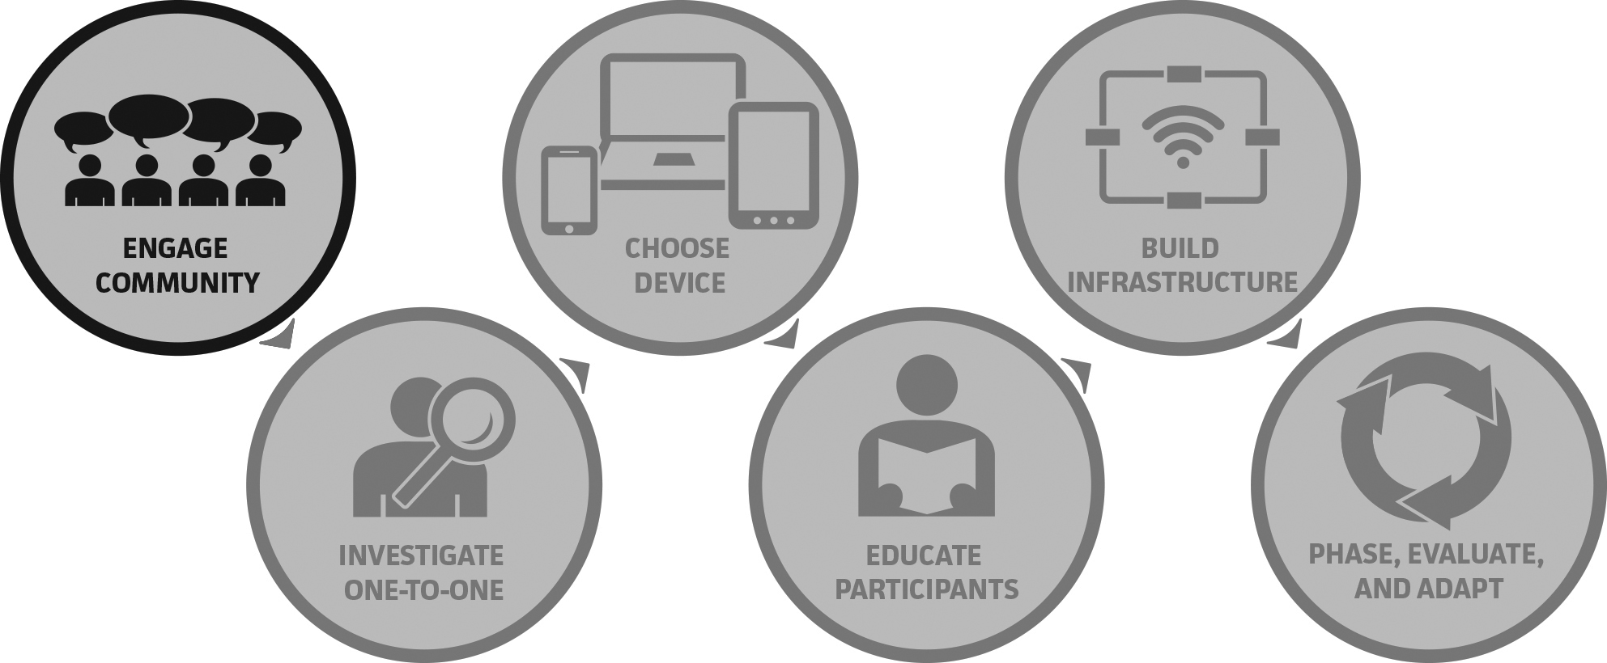
Personalized Learning
Engage the School Community

Slide 23
Personalized Learning
Engage the School Community
A successful one-to-one program requires the support and buy-in of all the parties involved, and the best way to accomplish this is to make them an active part of the decision-making process.
Developing a team to plan for mobile learning implementation is critical for success. A well-defined team that includes representatives who meet regularly will move the objectives of a district forward.

Slide 24
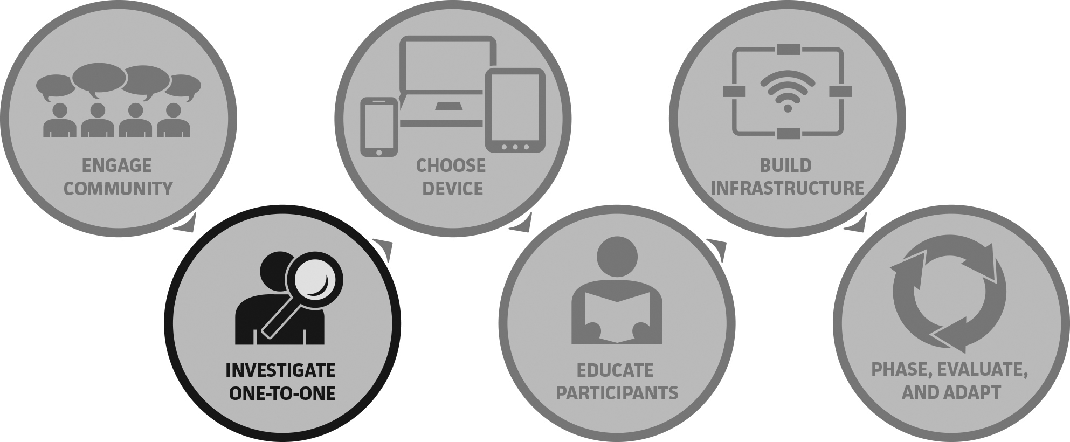
Personalized Learning
Investigate Personalized and One-to-One Learning

Slide 25
Personalized Learning
Investigate Personalized and One-to-One Learning
Committee members bring vast experience and knowledge about one-to-one learning, but systematic, thorough studies of research and theory are critical to ensure a positive outcome. A clear vision for one-to-one learning will identify directions for research, including specific conditions and characteristics of the school environment (demographics, state and local requirements, community characteristics, etc.)

Slide 26
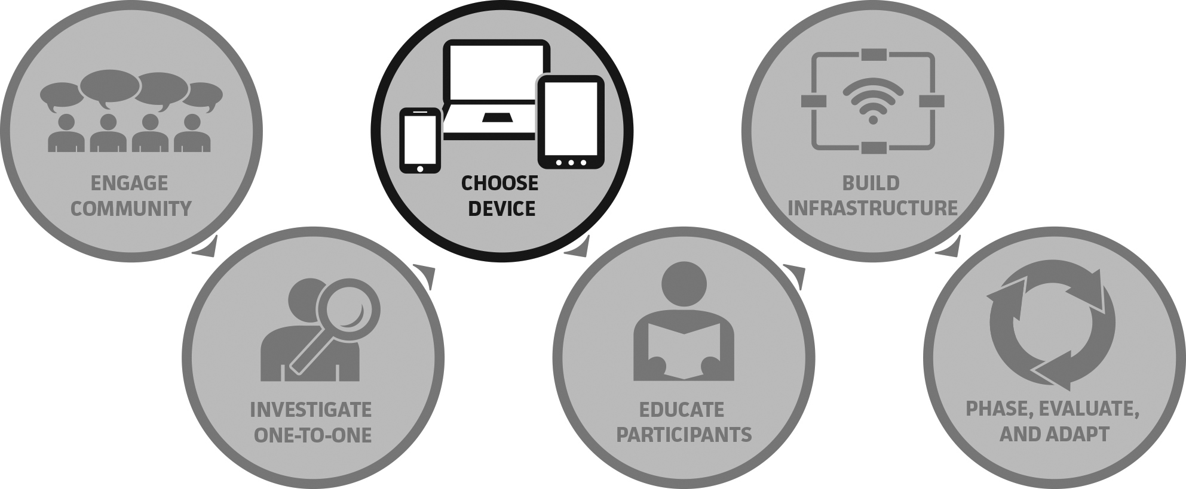
Personalized Learning
Choose a Device

Slide 27
Personalized Learning
Choose a Device
Perhaps the most time-consuming decisions to be made when planning a one-to-one program are choices about devices and implementation models. Competing expectations must be balanced with technology requirements, financial considerations, and issues of access and equity.

Slide 28
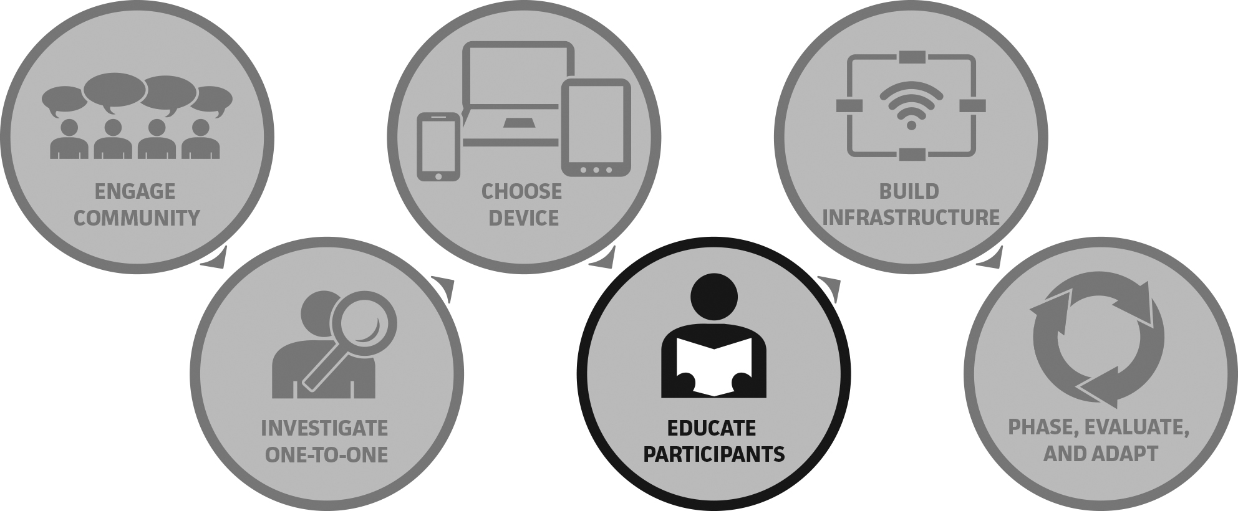
Personalized Learning
Educate Teachers and Other Stakeholders

Slide 29
Personalized Learning
Educate Teachers and Other Stakeholders
All proponents of one-to-one computing agree that professional development is the key to success. They understand that the journey to a personalized, one-to-one environment differs among teachers, depending on their teaching and learning experiences, their beliefs about how students learn, and their technological expertise.

Slide 30
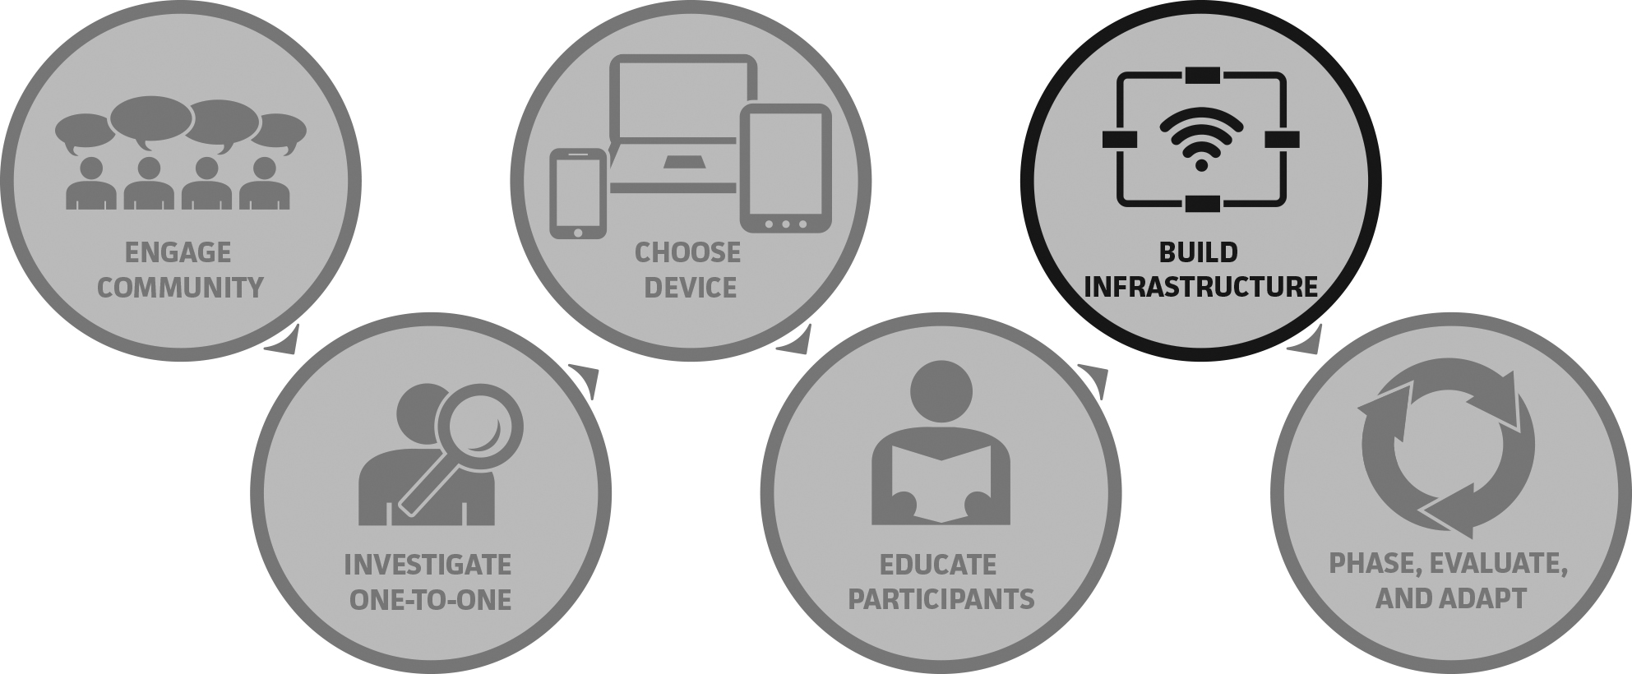
Personalized Learning
Build Infrastructure

Slide 31
Personalized Learning
Build Infrastructure
The infrastructure needs and demands of a mobile learning environment are extensive; if they are shortchanged, even the best implementation plan is bound to fail. Opening school doors to students’ and staff members’ devices will create heavy demands on your network’s infrastructure.

Slide 32
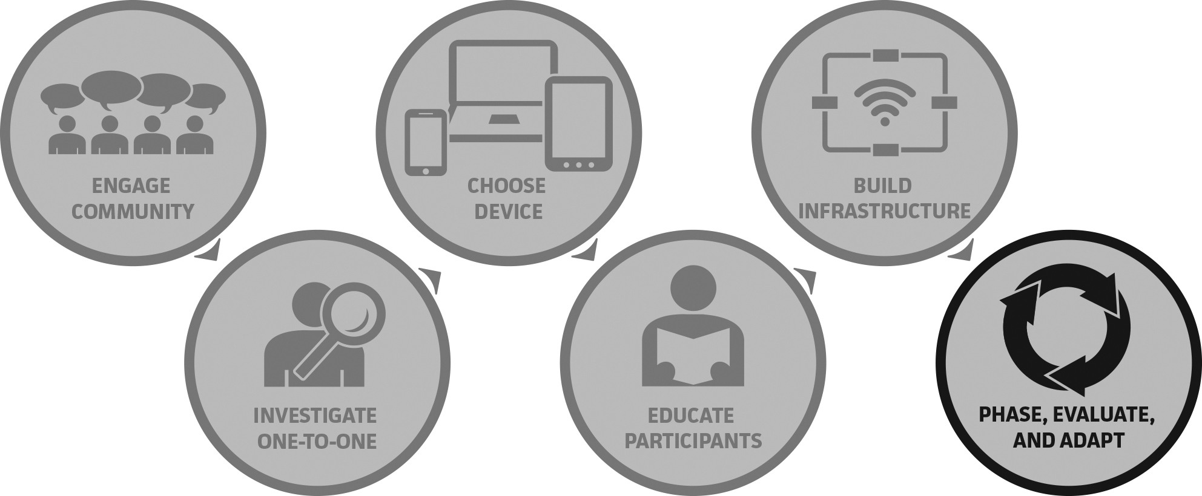
Personalized Learning
Phase, Evaluate, and Adapt

Slide 33
Personalized Learning
Phase, Evaluate, and Adapt
Implementing personalized one-to-one programs should be a combination of cautious moves forward and leaps of faith. One-to-one advocates can take a lesson from early attempts at technology integration, where expensive equipment purchased under technology initiatives gathered dust in closets due to ineffective implementation planning. On the other hand, waiting until everything is in place before starting a full-scale program can delay a potentially beneficial innovation indefinitely.

Slide 34
Personalized Learning:
Professional Development
What Is Personalized Learning?

Slide 35
Personalized Learning:
Professional Development
The Personalized Learning Facilitation Guide includes instructions, resources, and tips for conducting three workshops for principals and 6 workshops for teachers on personalized learning and related topics, built around the information and exercises in Personalized Learning: A Guide for Engaging Students with Technology.

Slide 36
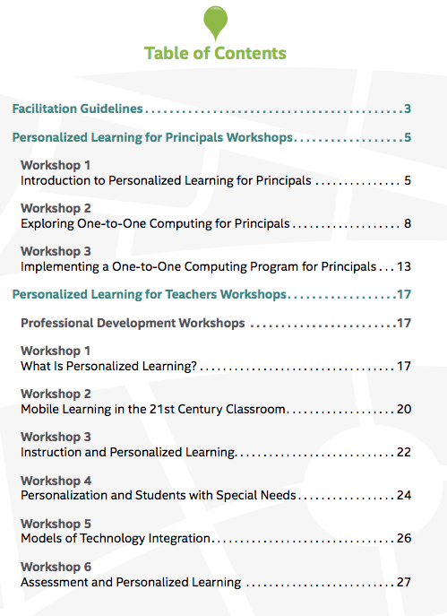
Personalized Learning Resources
Facilitation Guide

Slide 37
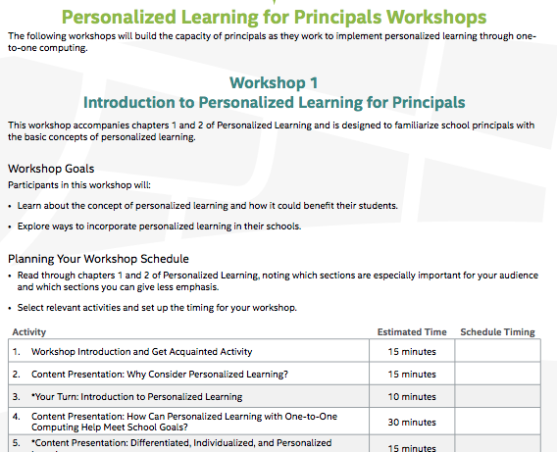
Personalized Learning Resources
Facilitation Guide

Slide 38
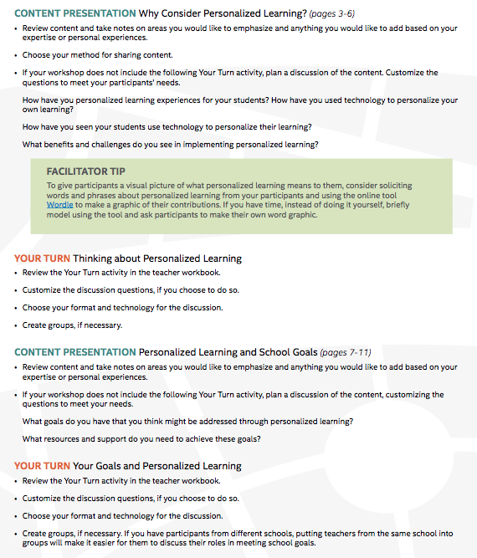
Personalized Learning Resources
Facilitation Guide

Slide 39
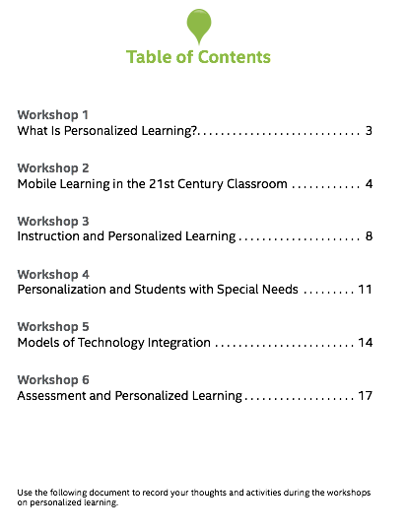
Personalized Learning Resources
Participant Handbook for Teachers

Slide 40
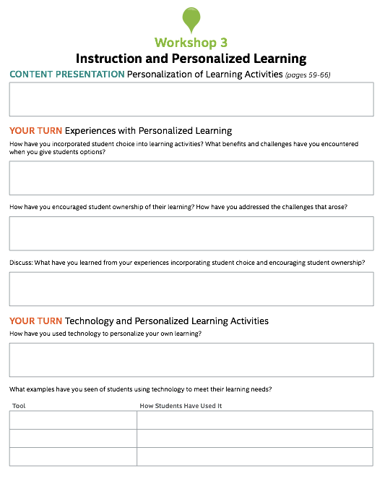
Personalized Learning Resources
Participant Handbook for Teachers

Slide 41
Personalized Learning
Professional Development
Features of Workshops
1-3 hours in length depending on choices
Interactivity that encourages active learning through application of concepts to participants’ specific environments.
Frequent opportunities for discussion, collaborative planning, and exchange of ideas.
Numerous optional activities to allow customization for different needs, audiences, times, and formats.

Slide 42
Personalized Learning for Principals
• Workshop 1: Introduction to Personalized Learning for Principals
• Workshop 2: Exploring One-to-One Computing for Principals
• Workshop 3: Implementing a One-to-One Computing Program for Principals

Slide 43
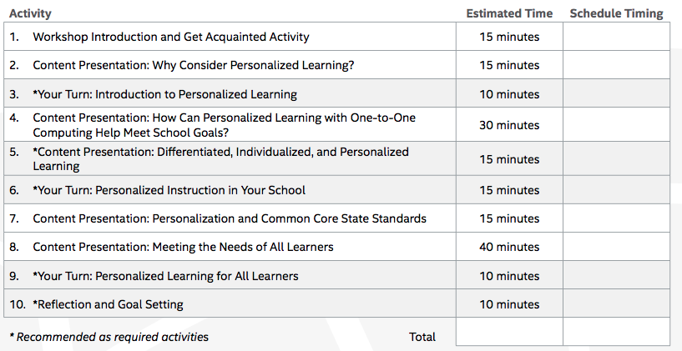
Sample Principal Workshop

Slide 44
Personalized Learning for Teachers
• Workshop 1: What Is Personalized Learning
• Workshop 2: Mobile Learning in the 21st Century Classroom
• Workshop 3: Instruction and Personalized Learning
• Workshop 4: Personalization and Students with Special Needs
• Workshop 5: Models of Technology Integration
• Workshop 6: Assessment and Personalized Learning

Slide 45
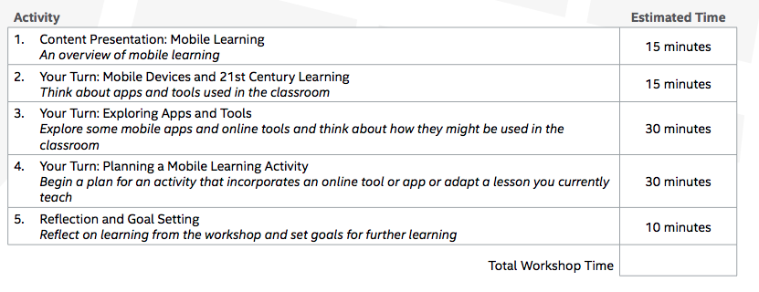
Sample Teacher Workshop

Slide 46
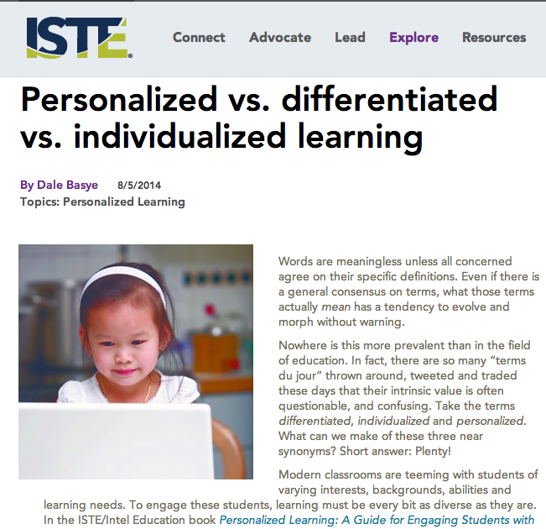
ISTE Blog

Slide 47
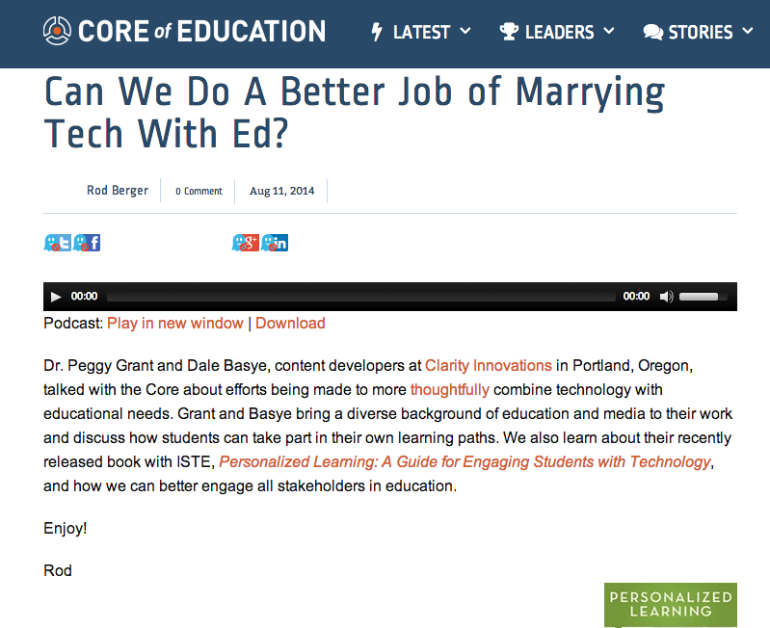
Core of Education

Slide 48
Professional Development Support
1. Virtual webinar with the authors
2. Available 1/2 day face-to-face workshop with the authors

Slide 49
7 Things Your Customers Should Know about Personalized Learning
What does it take to implement this approach to teaching and learning? Here are 7 things to get you thinking about personalized learning.

Slide 50
1. Personalized learning is a 21st century form of differentiation, refreshed with technology.
Personalized learning is an approach to instruction where students make choices about what and how they learn while developing self-direction skills and feelings of self-efficacy. The 21st century twist is that technology makes the whole process easier, more viable and more exciting.

Slide 51
2. Personalized learning focuses on academic standards
Personalized learning doesn’t mean that students just learn whatever appeals to them. They still have to demonstrate that they’ve met academic standards, but they don’t all have to learn or demonstrate their learning in the same way. Personalized instruction finds spaces within the required content for students to make choices, pursue their own interests and talents, and address areas where they are struggling.

Slide 52
3. Students are already personalizing their own learning.
On their own, students are already using social networks to collaborate on school projects, get homework help on the Internet, create projects with mobile apps, and find tutorials to help them catch up or move ahead with content and technology skills. How students are encouraged to use technology in the classroom, though, lags behind the ways they use it in their lives. Students expect to be able to learn on the go, any time, and anywhere. But they need the direction that teachers provide to get the most value out of their digital experiences. Personalized learning accomplishes that goal.

Slide 53
4. Personalized learning is not a curriculum or a program, but a way of thinking about teaching and learning that can transform classrooms.
Technology integration models such as blended, flipped, online, and mobile learning all incorporate aspects of personalized learning in the way that they use Internet connectivity and mobile devices to meet the individual needs of students. The key to personalization is the design of learning experiences that place the student, rather than the teacher, at the center of the learning process.

Slide 54
5. Technology is a critical tool for personalizing learning
With the proliferation of online tools and apps, students can show what they have learned in dozens of creative ways, such as through video, audio, or animation. Where learning expectations are rigorous and clearly defined, digital tools not only allow students to meet standards as they personalize their learning experiences, they also prepare them for school, life, and careers outside the classroom.

Slide 55
6. Personalized learning can transform teaching
The focus in the classroom shifts from emphasizing teacher performance and classroom control to the creation of an environment where students can take risks, collaborate, and learn while completing meaningful, complex tasks. Teachers in personalized classrooms are facilitators who know what their students need and organize activities that help them acquire understanding of content through discovery, application, and reflection.

Slide 56
7. Personalizing learning is worth the effort
When teachers thoughtfully plan lessons and projects that give students options and make expectations clear and rigorous, they create engaging, personalized learning experiences. And when principals support teachers with the technology they need, personalized learning can flourish and realize its potential. And all students can benefit from their efforts.

Slide 57
This resource sponsored by Intel Education
Thank You!

