Slide 1
Personalized Learning
This resource sponsored by Clarity Innovations
A Guide for Engaging Students with Technology

Slide 2
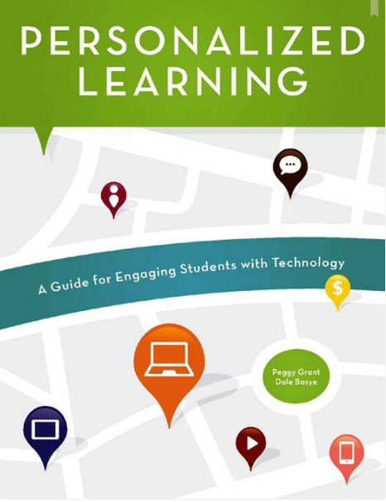

Slide 3
“Personalized learning is an invitation for educators to create opportunities for learning that takes advantage of the digital skills most students already possess.”
Introduction to Personalized Learning
—Paige Johnson, Education Strategist, Intel Corporation; ISTE Board of Directors

Slide 4
The Authors
Peggy Grant, a classroom teacher for over twenty years and teacher educator is a senior content developer at Clarity Innovations She creates online and face-to-face courses and other resources to facilitate the transformation of classrooms into places where students are actively learning with technology. Peggy’s goal is to provide educators with the tools they need to make every classroom a place where students are engaged in learning.
Dale Basye, an award winning author and creative director, is a content developer at Clarity Innovations where he works directly with teachers and schools on technology integration . He is also the author of The Nine Circles of Heck, a book series for young adults. Dale’s diverse skills and his experiences with children give him a unique perspective on educational practices that engage and inspire students in the 21st century.

Slide 5
Personalized Learning
Contents
Definition, description, and rationale for personalized learning
How personalized learning can transform teaching and learning
Information about one-to-one computing and resources for funding and policy support
A planning process for implementing a one-to-one, personalized learning program

Slide 6
Personalized Learning
Features
Frequent opportunities to interact with the ideas in the book:
Discussion questions
Reflection prompts
Application exercises
Planning tools

Slide 7
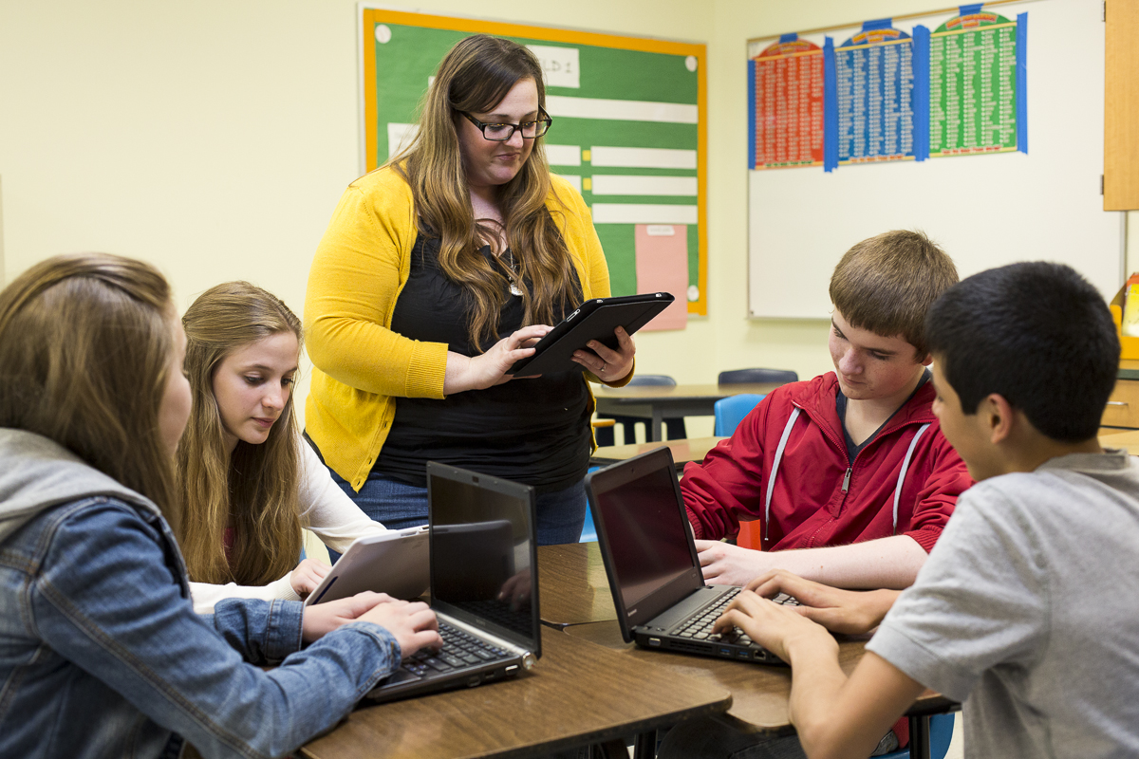
Personalized Learning
Features
Classroom examples
Tips
Recommended resources
Forms, surveys, and checklists

Slide 8
Personalized Learning:
Professional Development
What Is Personalized Learning?

Slide 9
Personalized Learning:
Professional Development
The Facilitation Guide includes instructions, resources, and tips for conducting three workshops for principals and 6 workshops for teachers on personalized learning and related topics, built around the information and exercises in Personalized Learning.

Slide 10
Personalized Learning
Professional Development
Features of Workshops
1-3 hours in length depending on choices
Interactivity that encourages active learning through application of concepts to participants’ specific environments.
Frequent opportunities for discussion, collaborative planning, and exchange of ideas.
Numerous optional activities to allow customization for different needs, audiences, times, and formats.

Slide 11
Personalized Learning for Principals
Workshop 1: Introduction to Personalized Learning for Principals
Workshop 2: Exploring One-to-One Computing for Principals
Workshop 3: Implementing a One-to-One Computing Program for Principals

Slide 12
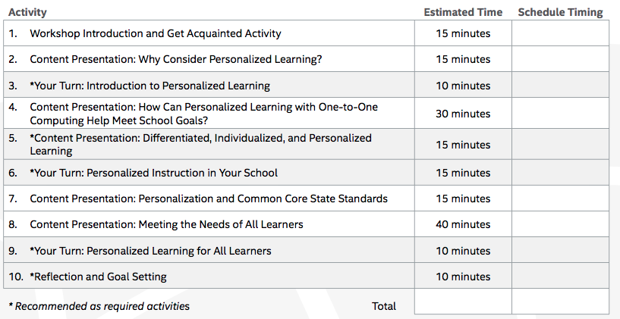
Sample Principal Workshop

Slide 13
Personalized Learning for Teachers
Workshop 1: What Is Personalized Learning
Workshop 2: Mobile Learning in the 21st Century Classroom
Workshop 3: Instruction and Personalized Learning
Workshop 4: Personalization and Students with Special Needs
Workshop 5: Models of Technology Integration
Workshop 6: Assessment and Personalized Learning

Slide 14
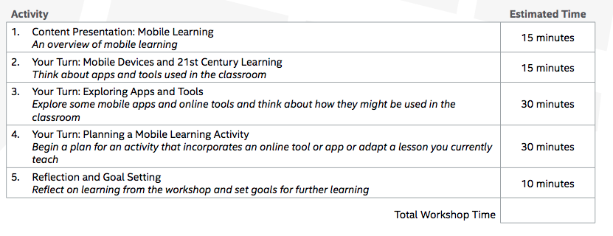
Sample Teacher Workshop

