Slide 1
Making the Case for Security

Slide 2
Data Security Advice for K-12 Leaders
It is increasingly important for schools and districts to understand data protection and cybersecurity, yet many school leaders struggle to understand what actions are required and how to comply with new legal requirements. School faculty need the knowledge and skills necessary to strengthen security policies and procedures.

Slide 3
Security Threats to Prepare For
Protecting your district’s network from cyberattacks becomes more challenging by the second. According to Verizon’s 2022 Data Breach Investigations Report, there were 23,896 security incidents, of which, 5,212 were confirmed data breaches.
Ransomware accounted for a total of 25% incidents, while supply chain issues were responsible for 62% of system intrusion incidents in 2021. Error continued to be a dominant trend, with 82% of breaches involving the human element.
In the education sector, there was a dramatic increase in ransomware attacks (over 30% of breaches), illustrating the need for protection against stolen credentials and phishing attacks potentially exposing the personal information of its employees and students.

Slide 4
Triple Threats
What are the specific threats school districts should be prepared for in the coming years?
Artificial intelligence can automate tedious tasks while increasing efficiency, but can also be used by hackers to bypass security protocols and avoid detection
Chrome OS Threats. On the heels of the pandemic, Google reported 50 million students and educators worldwide using ChromeOS. This sets the stage for a marked increase in threats impacting Chromebook in the year to come.
Voice-controlled devices can be exploited to conceal suspicious activities from users, with common commands reconfigured to trigger malicious activities

Slide 5
A School-wide Effort
Faculty need to understand that cybersecurity affects
all operations of school: everything from digital
learning in the classroom and regulatory concerns
such as FERPA to operations and even payroll.
Helpful Cybersecurity Efforts
Education and change management
Sending educators to education technology conferences
Continual management of compliance programs

Slide 6
Other Considerations
Student data policies are inextricably tied to governance, discipline, purchasing, and communications practices. School leaders should know that protecting student data privacy is a primary concern of parents and peers, and that no governance program can be effective without their support.

Slide 7
To Avert, You Must First Understand
According to Emsisoft Malware Lab’s The State of Ransomware in the US: Report and Statistics 2022 report, 89 education sector organizations were impacted by ransomware, just one more than the 88 which were impacted in 2021. However, districts impacted in 2021 had 1,043 schools between them but, in 2022, this almost doubled to 1,981 schools.
The most significant incident of the year was the attack on Los Angeles Unified School District which, with more than 1,300 schools and 500,000 students, is the second largest district in the U.S. At least three organizations paid a demand, including the Glenn County Education Office, CA. which paid $400,000.

Slide 8
Establishing a Zero Trust Ecosystem
A Zero Trust model forges a data-centric perimeter around school information comprised of powerful encryption methods—as well as stringent authentication techniques—as sloppy user access protocols undermine any security strategy.
Modern security requires visibility into who has the potential
to access data, while only allowing access when all risk factors are properly evaluated.
Notes:
Source image: shutterstock_695764816.jpg

Slide 9
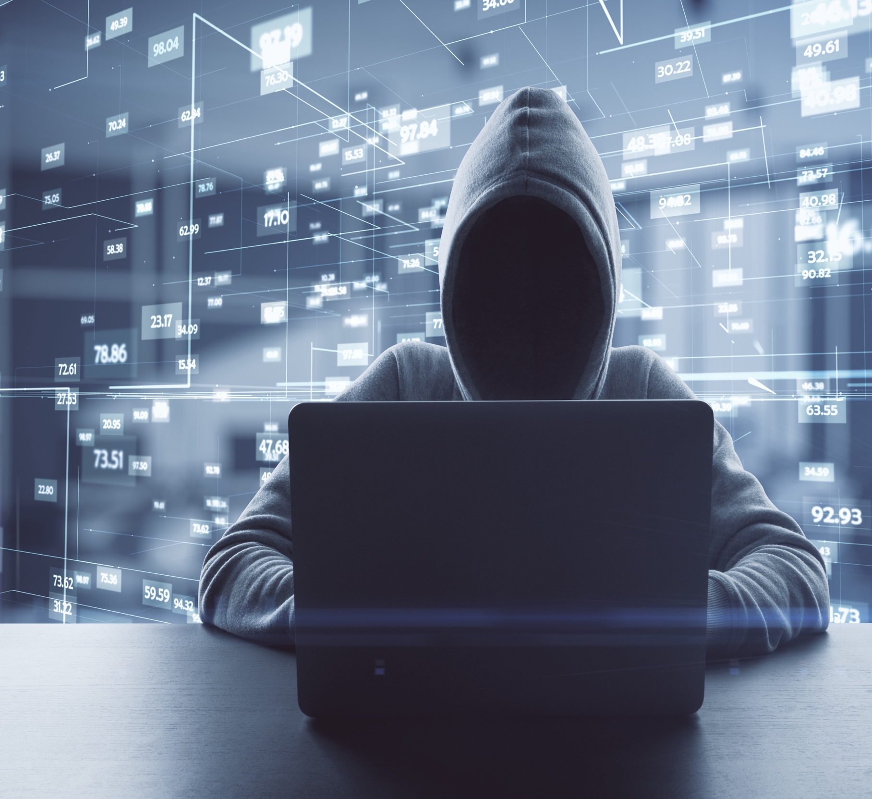
People Make (and Break) a Zero Trust Environment
Safeguarding school data with strong user authentication and strict access management is vital to a Zero Trust ecosystem. Schools need to accurately control who gets what access, to which data—and when—all the while protecting users from phishing attacks and credential theft.

Slide 10
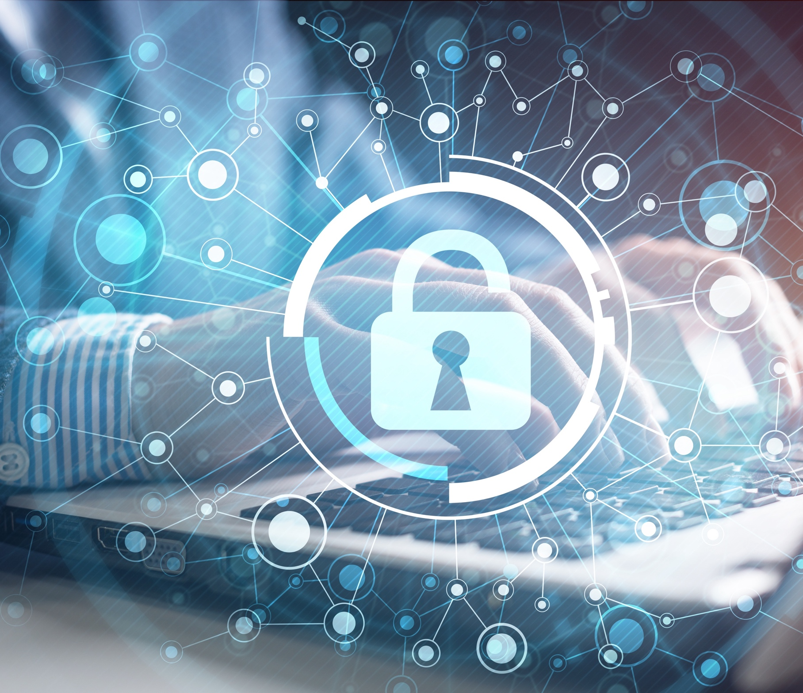
Follow the Leadership
The CoSN 2022 EdTech Leadership Survey reports that—though cybersecurity is the number one priority for IT Leaders— risks are underestimated, with only eight percent considering their district to be at an elevated risk for a ransomware attack.
Providing support for home access strains the resources of school district IT departments. More than half of districts are understaffed in their ability to provide remote support to students and families.

Slide 11
Practice Makes Perfect
The following practices work together to ensure Zero Trust.
Leadership Practices: Education leaders who embody and promote a security-first outlook
Professional Development Practices: Comprehensive staff training on the latest security practices
Business Practices: Ensuring that administrators and support staff follow sound security protocols
Classroom Practices: Safeguards and strategies to protect student data in the classroom
Data Security Practices: School- and district-wide protocols implemented by IT

Slide 12
Regulations Overview
GDPR: General Data Protection Regulation
FERPA: Family Educational Rights and Privacy Act
COPPA: The Children’s Online Privacy Protection Act
CIPA: Children’s Internet Protection Act
PPRA: Protection of Pupil Rights Amendment
CCPA: California Consumer Privacy Act

Slide 13
Creating Safe Learning Environments
Keeping students and their data safe, while maintaining
a modern and engaging learning environment, is a precarious juggling act.
A security operating platform can do much to protect students from inappropriate content through content filtering on school-owned devices both inside and outside the network.

Slide 14
Building a Cyber-Secure Culture
Mindset
When we build awareness into the organizational culture, we increase our ability to address cyber risks. Mindset will drive appropriate behaviors at the individual level, contributing to the resilient workforce that every organization needs.

Slide 15
Building a Cyber-Secure Culture
Leadership
Deep technical knowledge is not required from leaders; rather, they should model good personal security habits based on sound guidelines. Leadership involvement is critical for a cyber-secure organization.

Slide 16
Building a Cyber-Secure Culture
Training and Awareness
Once leaders foster a cyber-secure culture, the next step is to implement employee awareness training. These programs build an understanding of risks, and provide specific steps for mitigating them.

Slide 17
Building a Cyber-Secure Culture
Performance Management
Performance goals for security can include completion of required training, improved responses to phishing exercises, compliance with policies, and avoidance of risky online behaviors.

Slide 18
Building a Cyber-Secure Culture
Technical and Policy Reinforcement
Just as physical access controls reinforce the mental awareness of a physical perimeter, so can password policies, multifactor authentication and mobile device management solutions reinforce security culture.

Slide 19
In Fighting (Plat)Form
A Security Operating Platform typically provides the following overarching benefits:
Visibility of all users and devices across the network, including endpoint, cloud and SaaS (Software as a Service) applications.
Reducing the attack surface through integrated technologies.
Known threat prevention across different security controls for quick identification and threat response.
Unknown threat detection through the automated creation and delivery of near-real-time protections against new threats.

Slide 20
Ten Data Security Steps Every School District Should Take
Designate a Security Lead for IT Regardless of what your organizational chart looks like, there needs to be a senior technical staff member designated as the security lead.

Slide 21
Ten Data Security Steps Every School District Should Take
2) Communicate to stakeholders Stakeholders need to understand why certain measures are undertaken. Seek input on changes and help others to understand their importance.

Slide 22
Ten Data Security Steps Every School District Should Take
3) Seek legal counsel. Breaches can have legal implications, particularly if those they result in privacy issues. Once a breach occurs you’ll need to act quickly and knowing who to turn to is critical.

Slide 23
Ten Data Security Steps Every School District Should Take
4) Know best practices.
Stay current on security threats and how to deal with them. Active membership in professional associations and reading IT/security- related publications helps.

Slide 24
Ten Data Security Steps Every School District Should Take
5) Implement workable practices. What works for one industry may be too restrictive for education. Industry-specific guidance can be helpful.

Slide 25
Ten Data Security Steps Every School District Should Take
6) Partner with vendors. Technology providers know their technology better than anyone, so they are naturally a good source for security information.

Slide 26
Ten Data Security Steps Every School District Should Take
7) Leverage procurement. Build security requirements into the contract when contracting for any online services that will collect, manage, or store student and/or employee data.

Slide 27
Ten Data Security Steps Every School District Should Take
8) Provide training. For certain key positions, such as database administrators and network engineers, security training and relevant certifications should be considered job requirements.

Slide 28
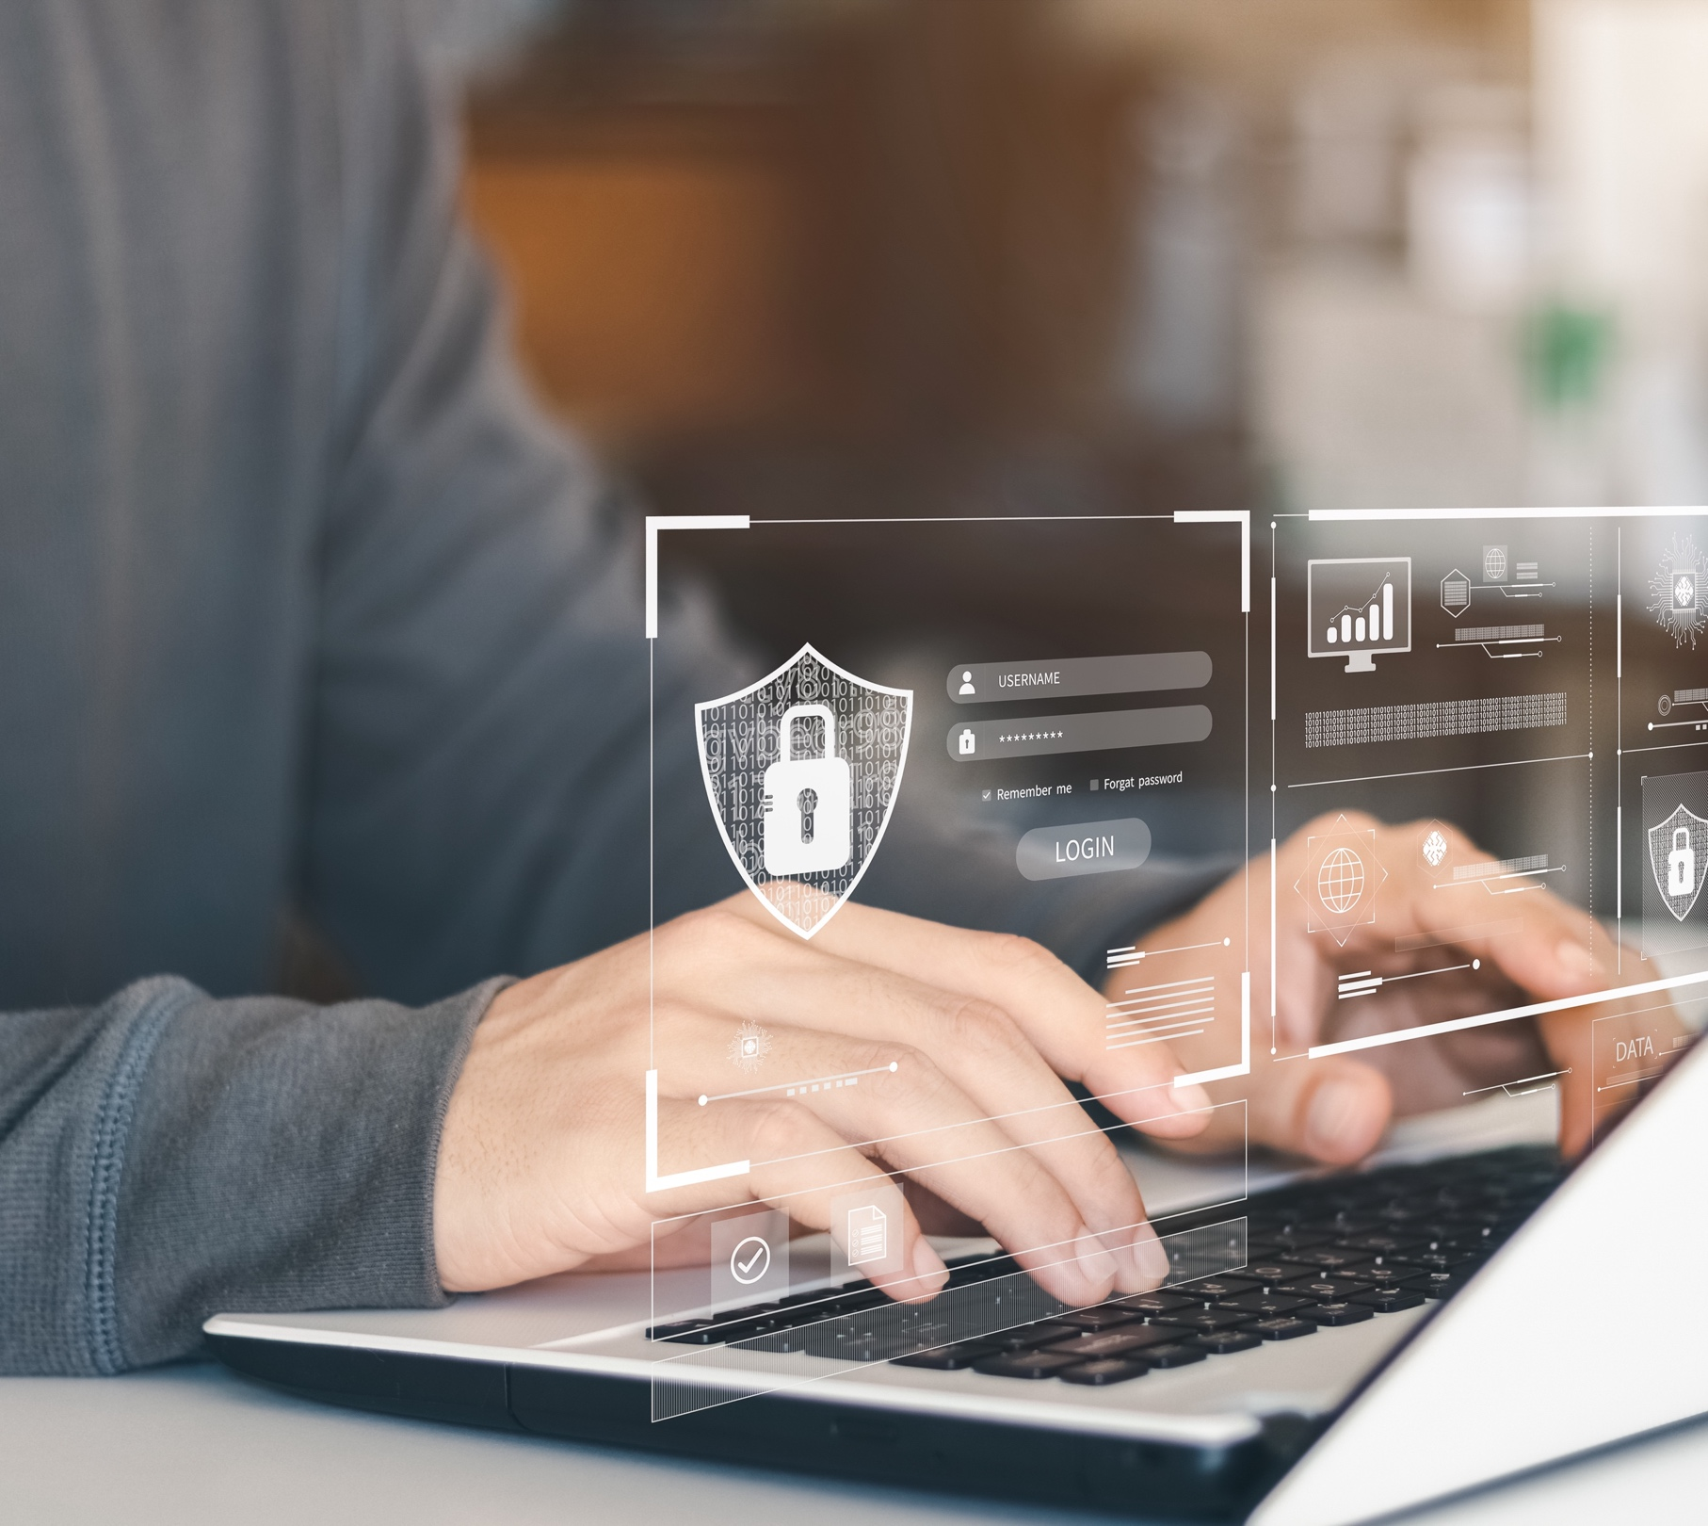
Ten Data Security Steps Every School District Should Take
9) Test your security.
A thorough audit will not only include tests of the technical security measures, but determine how well end users follow good security practices.

Slide 29
Ten Data Security Steps Every School District Should Take
10) Review and adjust.
By reviewing work regularly, you can ensure that you are striking a reasonable balance between good security and the freedom that teachers and students need.

Slide 30
Assaults and Protections for School and District Networks
Email. Schools should implement anti-phishing tools
Endpoint Protection. Ransomware and “cryptomining” grant hackers full control over a device. Endpoint products examine what processors are doing, what files are being modified, and prevent hostile takeovers.
Firewalls. Today’s firewalls have the ability to filter on a much deeper level than before.
Patching. Software should be regularly patched, or automatic patching tools should be implemented.
Spear Phishing. The practice allowing hackers the ability to infiltrate a school’s entire network through a staff member’s email account.

Slide 31
Does Your School Make the Grade?
Frosty Walker—CISO for the Texas Education Agency—has created a six-level framework for school IT professionals
A+ Data security is optimized
A Data security goes above and beyond minimal
regulatory requirements
B Security approach is defined, detailed and documented
C Security strategies are reactive and undocumented
D Security strategies are ad hoc, inconsistent or reactive
F Security measures are basically nonexistent

Slide 32
Security Questions for Online Service Providers
Data Collection.
What data does the provider collect?
What, if any, data is collected by third parties?

Slide 33
Security Questions for Online Service Providers
Network Operations Center Management and Security.
Does the provider perform regular penetration on testing, vulnerability management, and intrusion prevention?

Slide 34
Security Questions for Online Service Providers
Data storage and data access.
Where and how will the information be stored?
How does the provider protect data in transit?

Slide 35
Security Questions for Online Service Providers
Data and metadata retention.
How does the provider assure the proper management and disposal of data?

Slide 36
Security Questions for Online Service Providers
Development and change management process.
Does the provider follow standardized and documented procedures for coding, configuration management, patch installation, and change management for all servers?

Slide 37
Security Questions for Online Service Providers
Availability.
Does the provider offer a guaranteed service level?
What is the provider’s protection against denial-of-service attacks?

Slide 38
Security Questions for Online Service Providers
Audits and standards.
Does the provider provide the school system the ability to audit the security and privacy of records?
Have the provider’s security operations been reviewed or audited by an outside group?

Slide 39
Security Questions for Online Service Providers
Test and development environments.
Will “live” student data be used in non-production environments?
Are these environments secure to the same standard as production data?

Slide 40
Security Questions for Online Service Providers
Data breach, incident investigation and response.
What happens if your online service provider has a data breach?
Do you have the ability to perform security incident investigations?

Slide 41
For Peace of Mind, Prepare for the Worst
Despite the challenges, maintaining a secure network isn’t impossible. Here are some examples of what this technology should look like:
A comprehensive security system combining intrusion prevention, anti-virus, anti-malware, content/URL filtering and anti-spam services
E-rate eligible firewalls, wireless and WAN acceleration products
Children’s Internet Protection Act (CIPA) compliance with on-campus and off-campus web filtering

Slide 42
For Peace of Mind…Prepare for the Worst
A robust security plan that allows an IT team to gain real-time insight into network activity
Flexible remote access: Consider a next-generation firewall that does not rely on a third-party app, providing native VPN remote-client access for Windows, Chrome, Android and Linux devices
Routine patching while making updates to software to keep everything moving forward together

Slide 43
Security Starts with You
Establishing strong security policies and procedures—along with implementing robust yet cost-effective security platform solutions—are essential to maintaining security from all threats, regardless of where they’re coming from.

