Slide 1
This resource sponsored by Clarity Innovations
Bring Your Own Device
A Presentation for District Administrators

Slide 2

Objectives
Define the characteristics of a 21st century learning environment
Explore benefits, considerations, and impacts of BYOD
Develop a strategy for an effective and sustainable BYOD technology plan

Slide 3
Today’s Students
They are digital natives
They live in a multimedia world
Their media is all color
They prioritize visual learning
They demand creativity
They learn best through trial and error
They constantly connect and collaborate
They access information that is live and linked

Slide 4
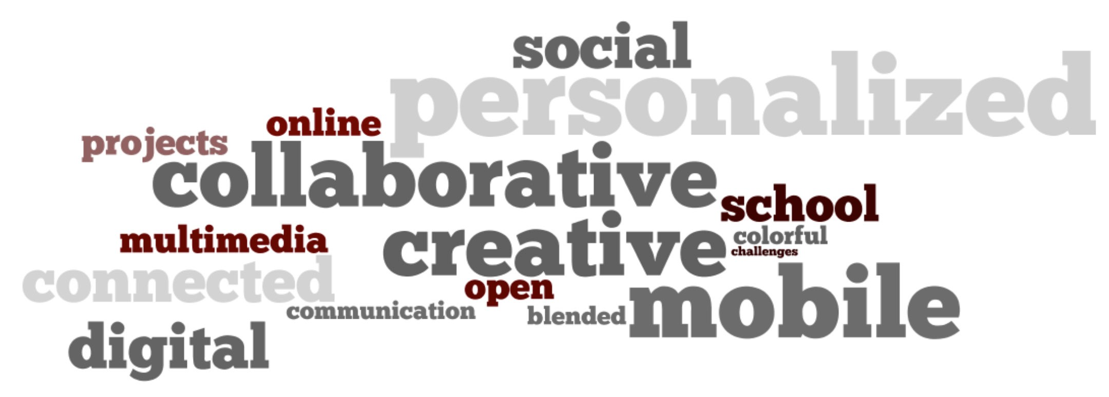
What should learning look like in the 21st century?

Slide 5
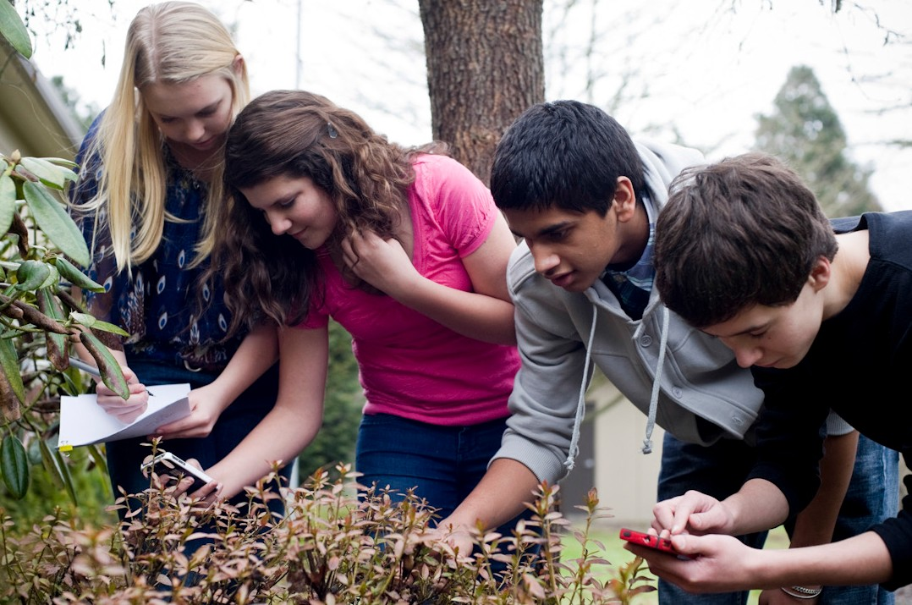
21st Century Learning is…
Mobile
Students live in a world with anytime, anywhere access to information at their fingertips.

Slide 6
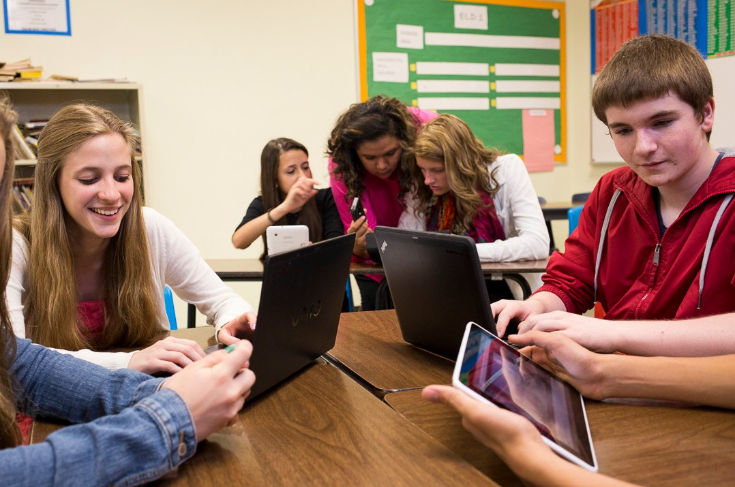
21st Century Learning is…
Collaborative
Technology has provided our students with a social, collaborative world. They thrive on teamwork and figuring things out with their friends.

Slide 7
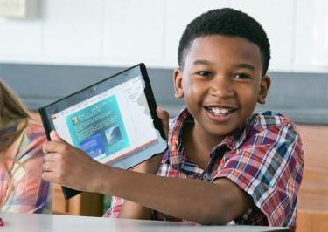
21st Century Learning is…
Connected
Today’s students want to connect with others in real time through social media and mobile devices.

Slide 8
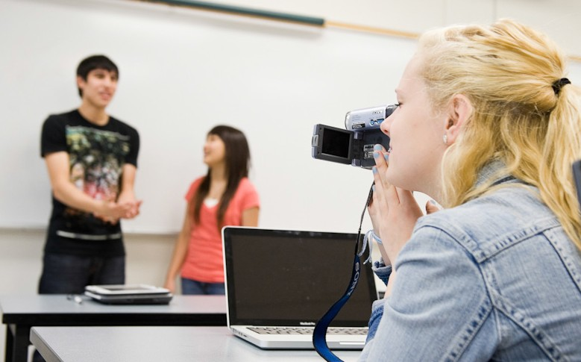
21st Century Learning is…
Multimedia
Today’s students are equal parts consumer and creator. They download and view audio and video, then create their own to upload and share with others. They are used
to having multimedia tools at their fingertips, and they are adept at using these tools to express their creativity.

Slide 9
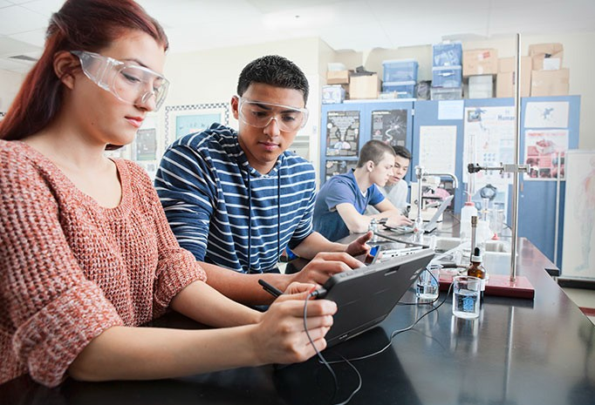
21st Century Learning is…
Constantly Changing
Constant change requires independent learners with new skills for changing work environments: critical thinking, collaboration, creativity, and communication.

Slide 10
21st Century Learning is…
Critical Thinking and Problem Solving
Collaboration across Networks and Leading by Influence
Agility and Adaptability
Initiative and Entrepreneurialism
Effective Oral and Written Communication
Accessing and Analyzing Information
Curiosity and Imagination

Slide 11
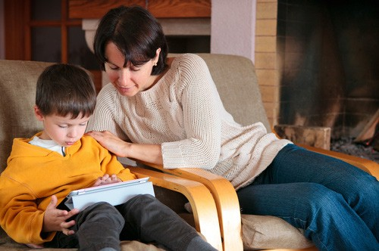
21st Century Learning is…
Physical and Virtual Learning Spaces
Students live in a world where they can learn anywhere, any time and from anyone.

Slide 12
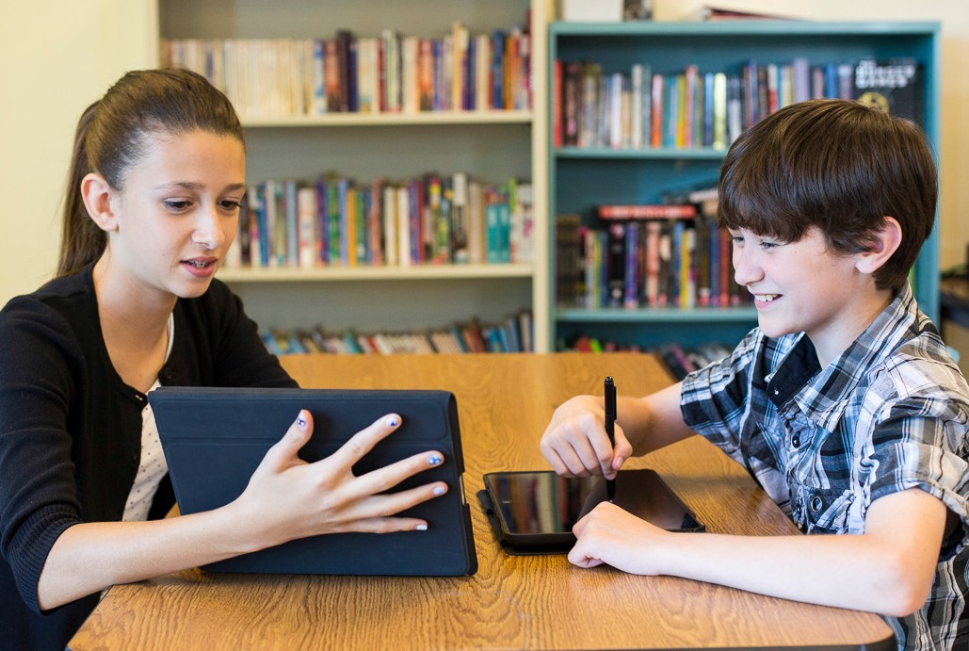
21st Century Learning is…
Student-Centered
Experiential
Personalized

Slide 13
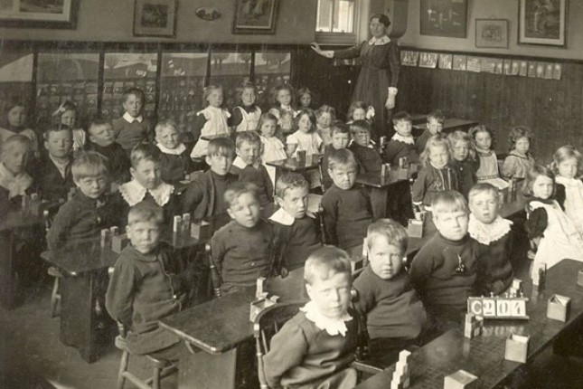
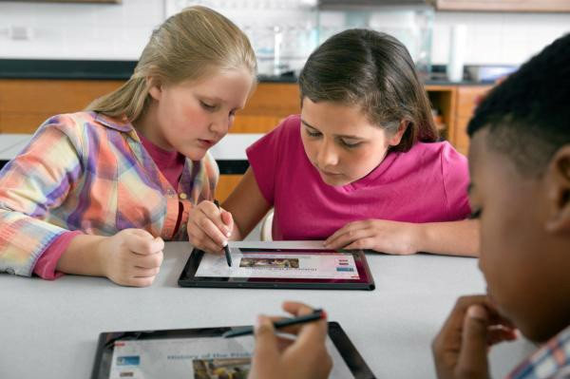
With a clear vision of 21st century learning, what do we need to get there?
Let’s examine 3 common technology integration models.

Slide 14
Technology Integration Models
1. Computer lab or mobile cart
School-financed devices
Controlled network access and security
Uniformity of device type, platform
Limited access
Requires scheduling and pre-planned learning activities
Students share devices
Costly upgrades and repairs

Slide 15
Technology Integration Models
2. One-to-one technology initiatives
Device for every student, anytime access
Uniformity of devices and platforms
Controlled access to the school network
School purchased, sometimes parent-financed
Costly upgrades and maintenance repairs
Devices may not be as up-to-date or have the same features as devices that students use outside of school
Large demands on the technology budget

Slide 16
Technology Integration Models
3. Bring Your Own Device
Device for every student, anytime access
Parent-financed
Devices typically up-to-date
No cost for upgrades or repairs
Lack of uniformity of devices and platforms
Uncontrolled network access
Requires a robust network infrastructure with large bandwidth
Limitations of mobile devices

Slide 17
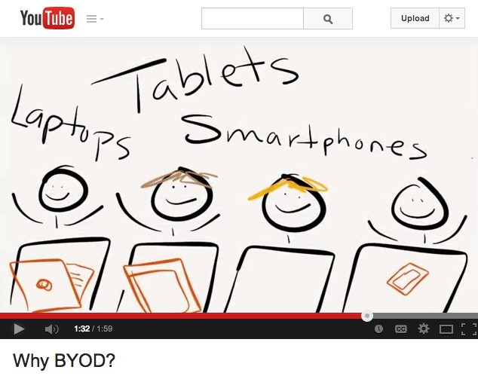
Comparing technology integration models
(Click to play video)

Slide 18
BYOD Benefits
Learning anytime, anywhere without schedule or access restrictions
Parent-financed, allowing schools to devote much-needed funding to other programs or technologies
Personalized devices
Devices are commonly more up- to-date with newer features
No repairs or maintenance
Cost-effective, works with decreasing technology budgets
Allows for immediate application in the classroom
Competitive pricing of tablets, smartphones, and laptop computers—BYOD a viable option for many families
Replicates a technology-rich environment already common in higher education and business
Flexibility—support different learners with different needs

Slide 19
But how many students already own a device?
(Collect data and present it here)

Slide 20
Will the parents support BYOD?
(Collect data and present it here)

Slide 21
BYOD Challenges and Considerations
Network security concerns include data protection and student privacy
Multiple platforms and devices
Parent-financed, not a viable option for some districts
Requires a shift in pedagogy and a new approach to education- teacher as facilitator
Update network infrastructure and increase bandwidth
Extensive professional development for teachers
Off-task behavior, inappropriate use of devices
Requires buy-in from all stakeholders- parents, students, staff, administrators, school board
Mobile device limitations- screen size, battery life, lack of
keyboard, software compatibility, support for Flash and other multimedia files

Slide 22
Planning a Successful BYOD Program
Engage the Community
Develop a Team
Develop the Physical Infrastructure
Develop the Software Infrastructure
Develop a Portal
Develop an Acceptable Use Policy
Build a Curriculum
Consider Devices
Provide Ongoing Professional Development

Slide 23
BYOD Educational Impact
More engaged and motivated students
Students are held accountable for their learning, puts them in charge
Encourages continued learning outside of the classroom walls
Personalized, students tap into their individual learning preferences
Helps students identify skills that will make them life-long learners
Gives students a preview of how their future workplaces will operate

Slide 24

Meet Mike
Mike arrives at school with his cell phone
in his hand. Already he has connected with three of his friends and made plans to meet up at lunch time. During his first class, the teacher posts a question on the interactive whiteboard. Mike and the other students
respond to the question using their cell phones, then view the results in real-time on the board. This starts a class discussion, where Mike pulls his tablet computer out of his backpack to look up information that will support his opinion. At the height of discussion, the bell signals the end of class. The teacher promptly posts the question on the class website discussion forum. Mike reads and responds to his classmates’ continued discussion on his way to the next class

Slide 25
Meet Mike
At lunch, Mike asks his friends for their opinions and adds their point of view to the discussion forum. Later that evening, Mike is at home listening to a podcast that he has downloaded. This inspires him to create his own podcast to present and
discuss his opinion on the topic. He uploads the podcast to the class website, where his peers promptly receive it on their own mobile devices. They leave comments on the site. The next day, the teacher uses these comments as material to launch
a new discussion. Mike eagerly pulls out his cell phone for another real-time poll.

Slide 26
BYOD encourages Mike to be:
Engaged in learning
Self-motivated
Self-directed
Independent
Creative
Collaborative
Communicative
A critical thinker

Slide 27
How can BYOD be used?
Data organization tools
Web-based applications for classroom polling & quick tests
Audio for podcasting and radio broadcasts
Video
QR codes
Digital storytelling
Language learning
Probe attachments for measuring data
Course companion sites

Slide 28
This resource sponsored by Clarity Innovations
How can we inspire our students and engage them in learning?
Viewed within a realistic perspective of both its benefits and limitations, BYOD can provide a workable solution for upgrading and sustaining educational technology in our schools.

